Slide 1

Dr. D. Y. Patil institute of technology, Pimpri
Department of Artificial Intelligence & Data Science
Presentation on “Internship Report”
APP Developer Intern
ARISE Vishwa Society
1st January 2025-15th February 2025(1Month 2 weeks)
Internship Guide
Mrs. Priya Metri
Vaishnavi Sanjay Babar
TEAI&DSA19

Slide 2
Outline
Internship Mission
About industry (of your internship)
Internship Tasks
Breakdown [Gantt chart]
Skills utilized in internship
What did I learn in internship
Internship Impact
Conclusion
Internship offer letter
Internship completion certificate
Note: PPT must be prepared point wise, not descriptive, Put images as per your need

Slide 3
Internship Mission
Developed a social help application for students aged 14-18 in rural areas.
Focused on educating students on manners, awareness, and career development.
Conducted under Arise Vishwa Society, a social welfare organization.
Aimed at providing students with a structured path to a better future despite their environment.

Slide 4
About the Industry (NGO & Social Welfare)
Industry: Non-Governmental Organization (NGO) & Social Welfare.
Focuses on empowering underprivileged communities through education and awareness.
Encourages technology-driven solutions for community development.
Works on student welfare, environmental care, and financial literacy.

Slide 5
Internship Tasks
Understanding Student Needs: Conducted research in two government schools.
App Development: Created a 6-component mobile application.
Personal Development Module: Emotion detection quiz, career path recommendations, and general knowledge quiz.
Multi-language Support: Implemented Hindi, English, and Marathi options.
UI/UX Design: Developed an interactive and engaging app interface.

Slide 6
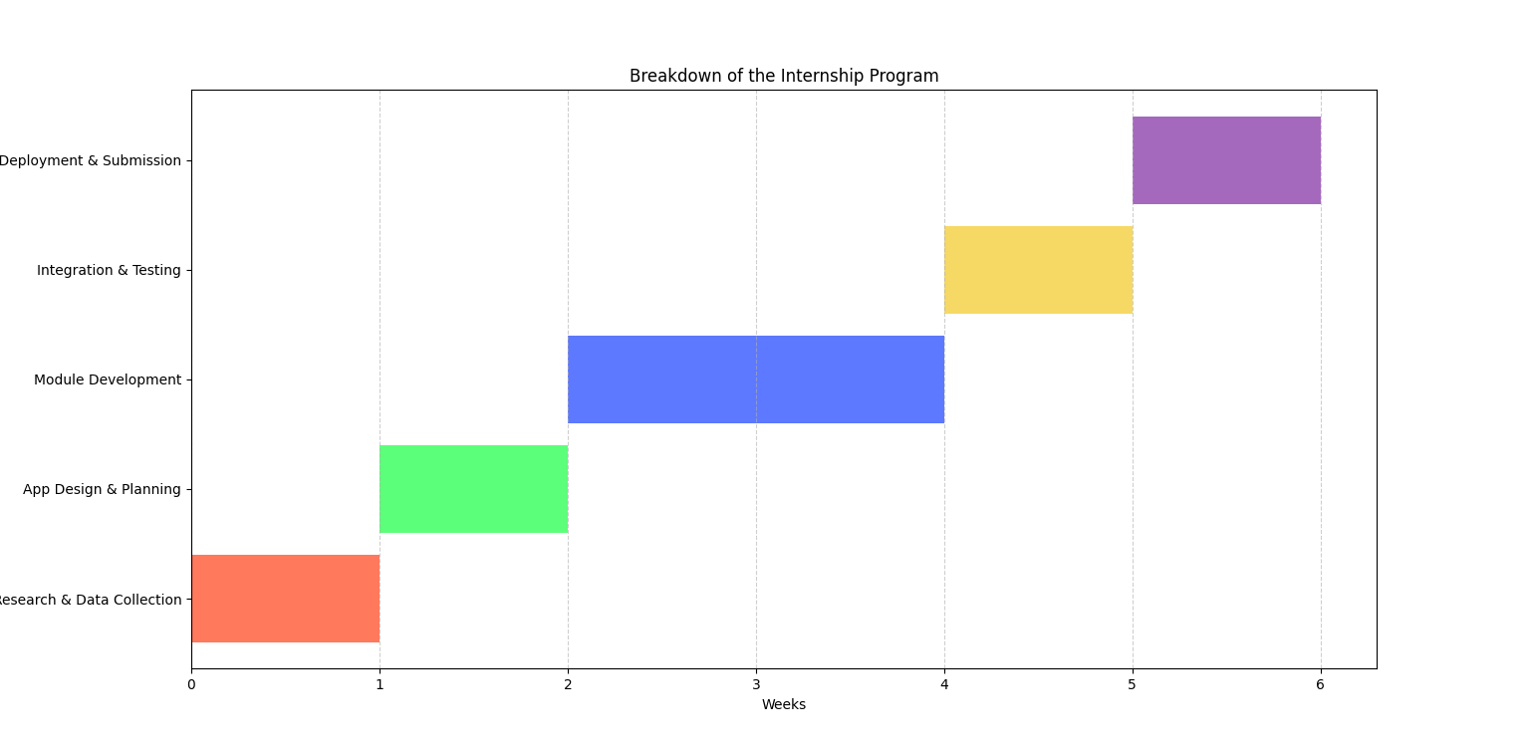
Breakdown (Gantt Chart)

Slide 7
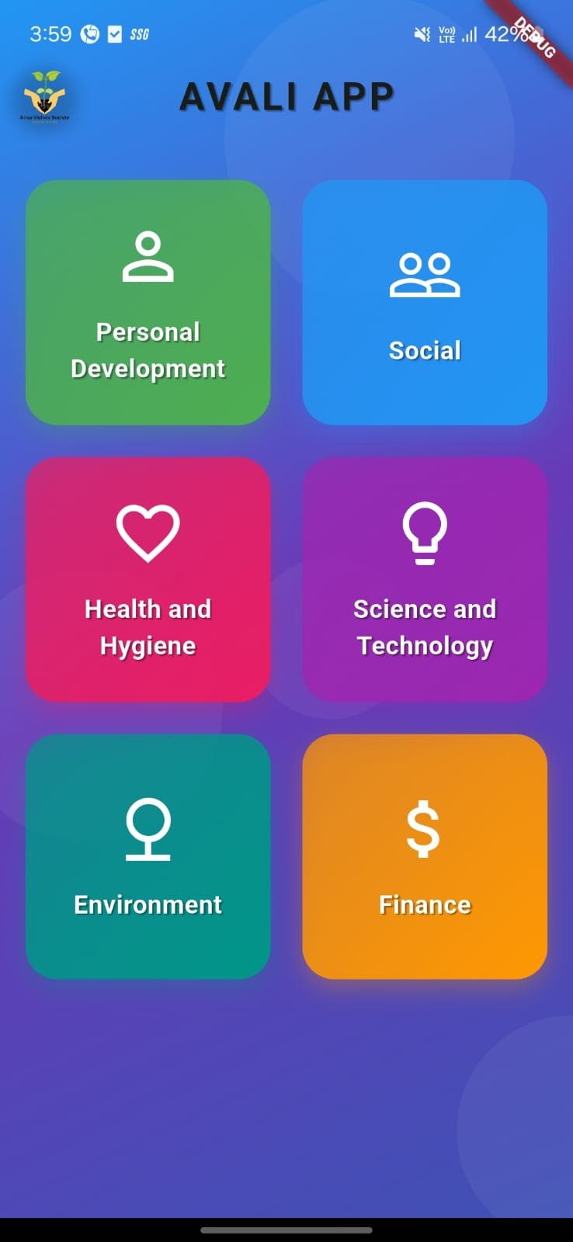
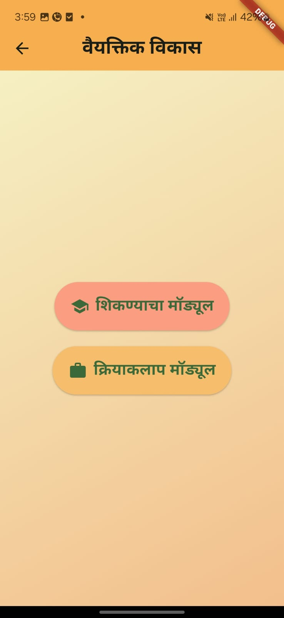
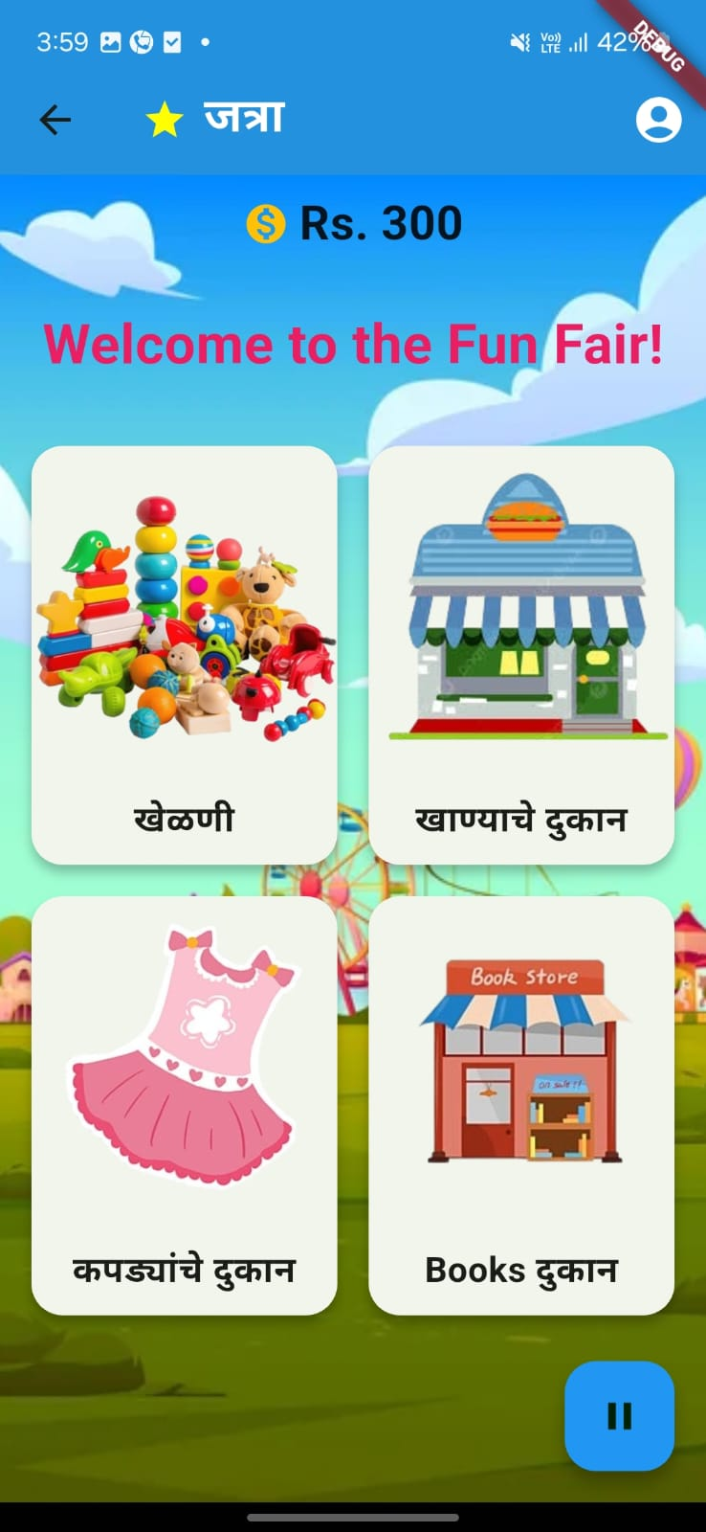
Application's Snippets

Slide 8
Skills Utilized in Internship
Technical Skills:
Flutter (App Development)
UI/UX Design (Colorful assets, interactive elements)
Multi-language Programming
Quiz & Game Module Development
Soft Skills:
Teamwork & Collaboration
Research & Problem-Solving
Communication & Student Interaction
Time Management

Slide 9
What I Learned in Internship
Technical Learning:
Mobile app development using Flutter.
Implementing multilingual support in apps.
Creating interactive quizzes and emotion detection games.
Soft Skills Growth:
Understanding social challenges in education.
Effective team collaboration.
Researching and analyzing real-world problems.
Presenting and delivering impactful solutions.

Slide 10
Internship Impact
Students Benefited: Empowered students with knowledge, career guidance, and personality development tools.
NGO Implementation: Provided a fully functional app (NGO App) for long-term usage.
Personal Growth: Improved technical skills, problem-solving abilities, and leadership experience.
Social Impact: Helped underprivileged students gain access to better resources for their future.

Slide 11
Conclusion
This internship enhanced both my technical and social skills.
Gained real-world experience in problem-solving and app development.
Developed an app that has the potential to impact many students positively.
Strengthened my ability to work in a team, manage a project, and contribute to a social cause.

Slide 12
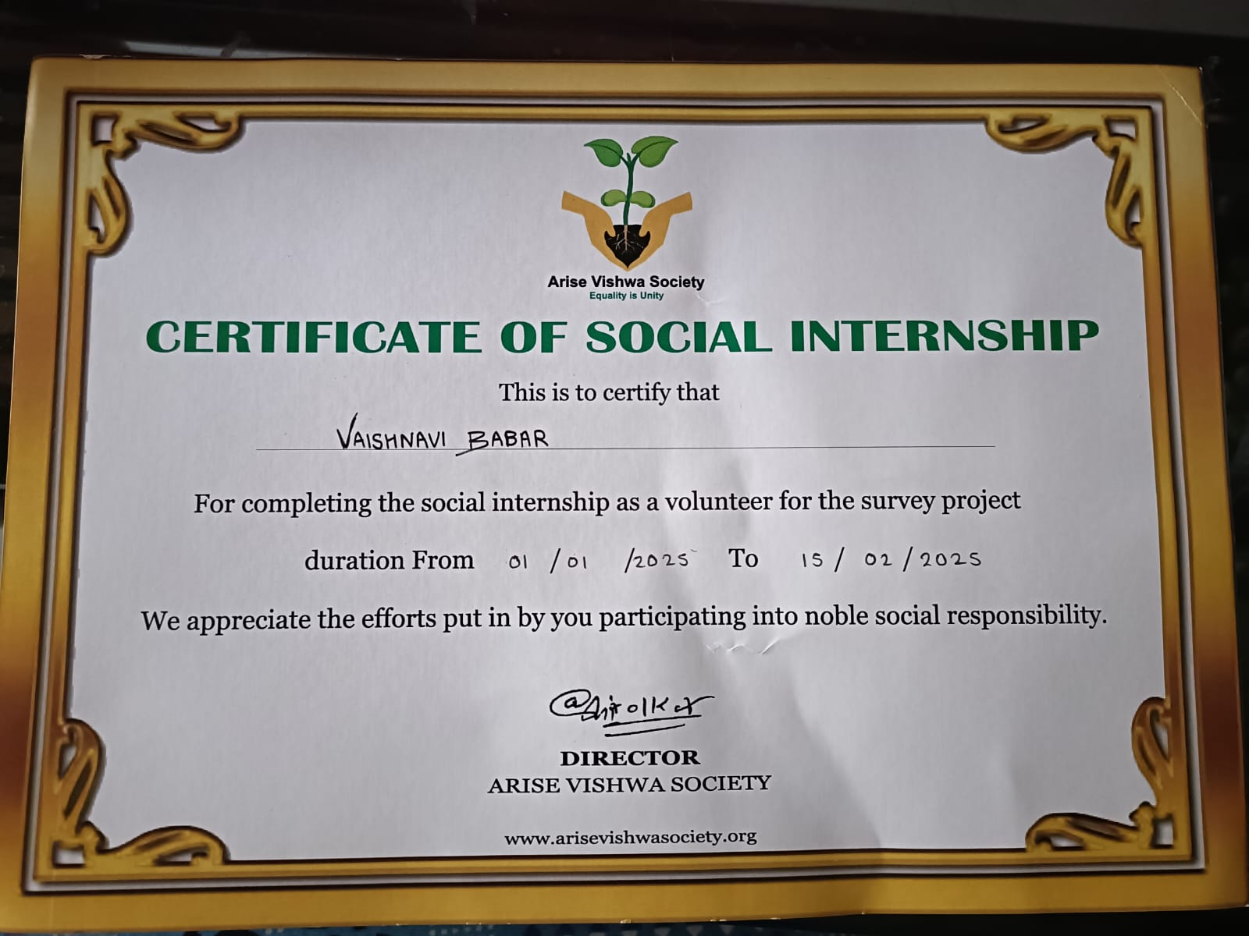
Internship Completion Certificate

